Slide 1



Automated Reasoning about Software ($67532$)
Guy Katz
Lecture $3$: SAT Solvers and CDCL October $29$^{nd}, $2018$

Slide 2
Acknowledgements
Some of the material presented has been borrowed from slides by David Dill, Isil Dillig, Gera Weiss, Clark Barrett, Alex Aiken, Mooly Sagiv, Masahiro Sakai and Ofer Strichman

Slide 3
Overview
Last time: basic algorithm for modern SAT solvers
DPLL: Search and deduction
Pure literal propagation (PLP)
Boolean constraint propagation (BCP)
Today: improvements that modern solvers use
Non-chronological backtracking
Learning conflict clauses
Heuristics for a smarter search
Implementation tricks

Slide 4


Non-Chronological Backtracking
Basic DPLL:
Assign $x←T$
If that doesn’t work, flip decision and try $x←F$
This is called chronological backtracking
This is often sub-optimal
What If the bad decision was made $100$ decisions ago?
Non-chronological backtracking lets us jump to earlier decision levels
Also known as backjumping
Satisfy($φ$)
If BCP() returns $F$, return $F$
Assign appropriate values to all pure literals
If every clause of $φ$ has true literal, return $T$
Choose variable $x$ that is unassigned in $A$, choose $v∈\{T,F\}$
$A_{backup}≔A$
$A\left(x\right)←v$; if Satisfy($φ$) return $T$
$A≔ A_{backup}$
$A\left(x\right)←¬v$; if Satisfy($φ$) return $T$
$A≔ A_{backup}$
Return $F$

Slide 5
























Non-Chronological Backtracking (cnt’d)
Variables: $x_{1},x_{2},x_{3}$
$$x_{1}$$
$$F$$
$$T$$
$$x_{2}$$
$$x_{2}$$
$$F$$
$$T$$
$$F$$
$$T$$
$$x_{3}$$
$$x_{3}$$
$$x_{3}$$
$$x_{3}$$
$$F$$
$$T$$
$$F$$
$$T$$
$$F$$
$$T$$
$$F$$
$$T$$

Slide 6
Non-Chronological Backtracking (cnt’d)
Variables: $x_{1},x_{2},x_{3}$
$$x_{1}$$
$$F$$
$$T$$
$$x_{2}$$
$$x_{2}$$
$$F$$
$$F$$
$$T$$
$$x_{3}$$
$$x_{3}$$
$$x_{3}$$
$$F$$
$$F$$
$$T$$
$$F$$
$$T$$

Slide 7
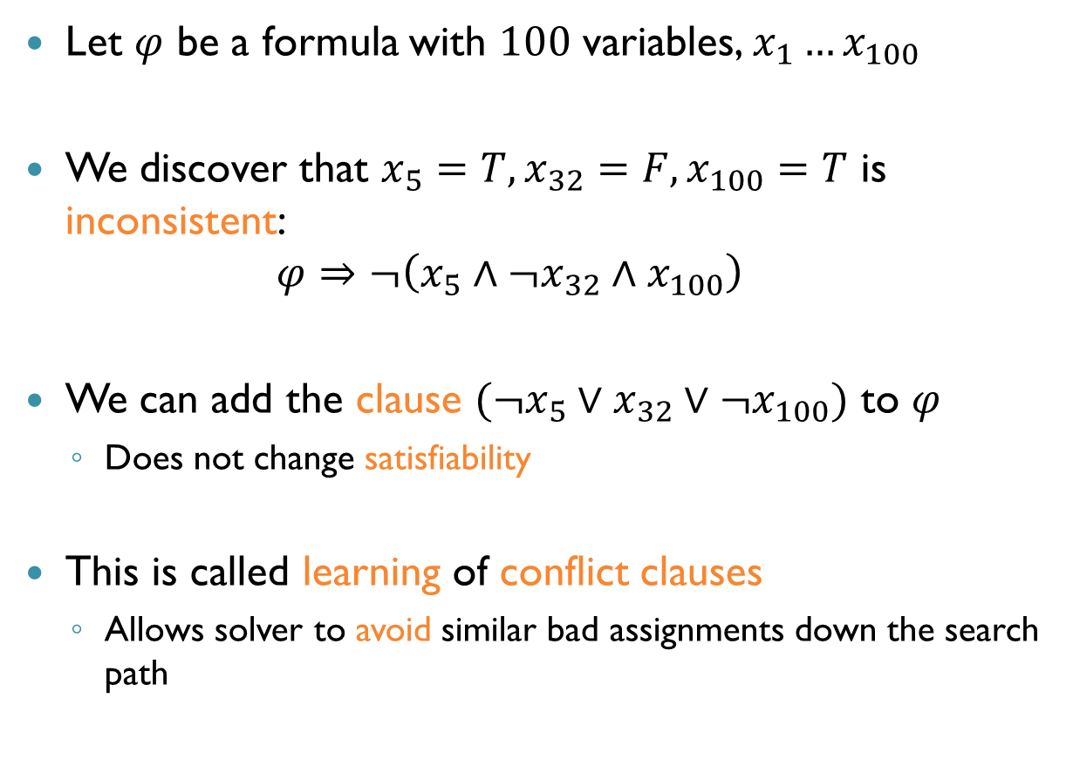
Learning Conflict Clauses
Let $φ$ be a formula with $100$ variables, $x_{1}…x_{100}$
We discover that $x_{5}=T,x_{32}=F,x_{100}=T$ is inconsistent: $φ⇒¬\left(x_{5}∧¬x_{32}∧x_{100}\right)$
We can add the clause $(¬x_{5}∨x_{32}∨¬x_{100})$ to $φ$
Does not change satisfiability
This is called learning of conflict clauses
Allows solver to avoid similar bad assignments down the search path

Slide 8

Learning Conflict Clauses (cnt’d)
Variables: $x_{1},x_{2},x_{3}$
Learn: $x_{2}∨x_{3}$
$$x_{1}$$
$$F$$
$$T$$
$$x_{2}$$
$$x_{2}$$
$$F$$
$$T$$
$$F$$
$$T$$
$$x_{3}$$
$$x_{3}$$
$$x_{3}$$
$$x_{3}$$
$$F$$
$$T$$
$$F$$
$$T$$
$$F$$
$$T$$
$$F$$
$$T$$

Slide 9








Decision Heuristics
DPLL does not specify:
How split variables are selected
Which assignment branch, $T$ or $F$, is explored first
A bit of voodoo, but apparently very important
$$x_{3}$$
$$F$$
$$T$$
$$x_{2}$$
$$F$$
$$T$$

Slide 10
Conflict Analysis
A key ingredient of backjumping and clause learning is conflict analysis
Idea: BCP doesn’t just say UNSAT, but tries to explain why
Enter conflict analysis mode
To facilitate this, past deductions are stored in an implication graph
But first, some terminology

Slide 11
Terminology: Decisions, Levels
Decision (split) variable: the variable being assigned in the search step
Decision level: the order in which variables are assigned
Corresponds to the layer in the search tree
The decision level of a variable assigned in BCP is the same as that of the last assigned decision variable

Slide 12



Decision Levels: Example
$$\left(¬x_{1}∨x_{2}\right)∧(¬x_{3}∨¬x_{4})$$
Decide: $x_{1}←T$
$x_{1}$ is the decision variable with level $1$
BCP yields: $x_{2}←T$
Decision level of $x_{2}$:
Decide: $x_{4}←T$
BCP: $x_{3}←F$
Decision levels for $x_{3}, x_{4}$?
$$1$$
$$2$$

Slide 13
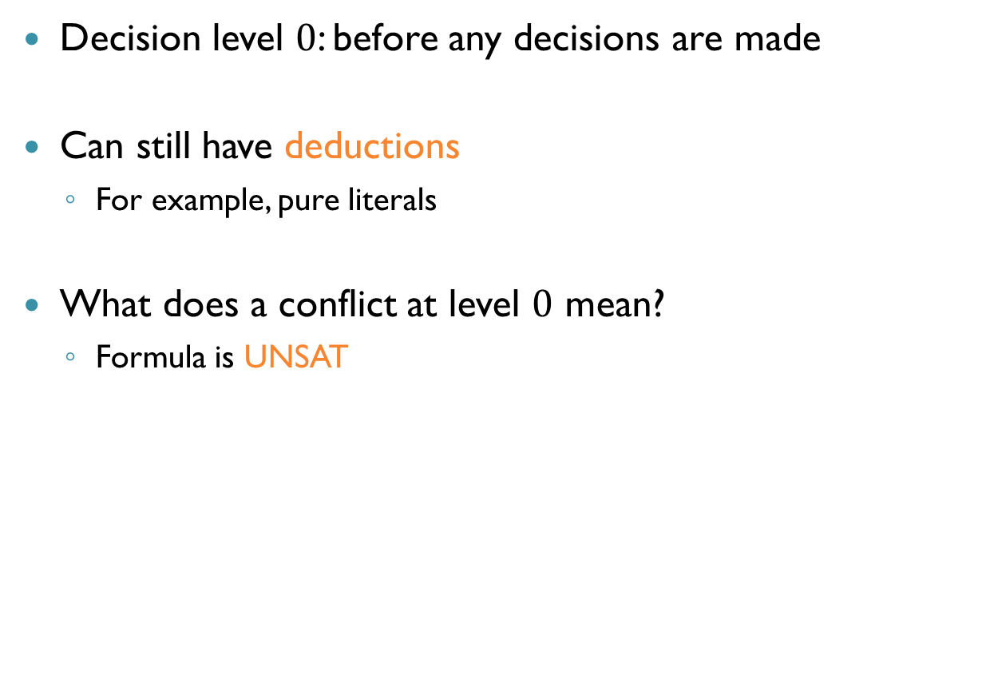

Decision Level $0$
Decision level $0$: before any decisions are made
Can still have deductions
For example, pure literals
What does a conflict at level $0$ mean?
Formula is UNSAT

Slide 14
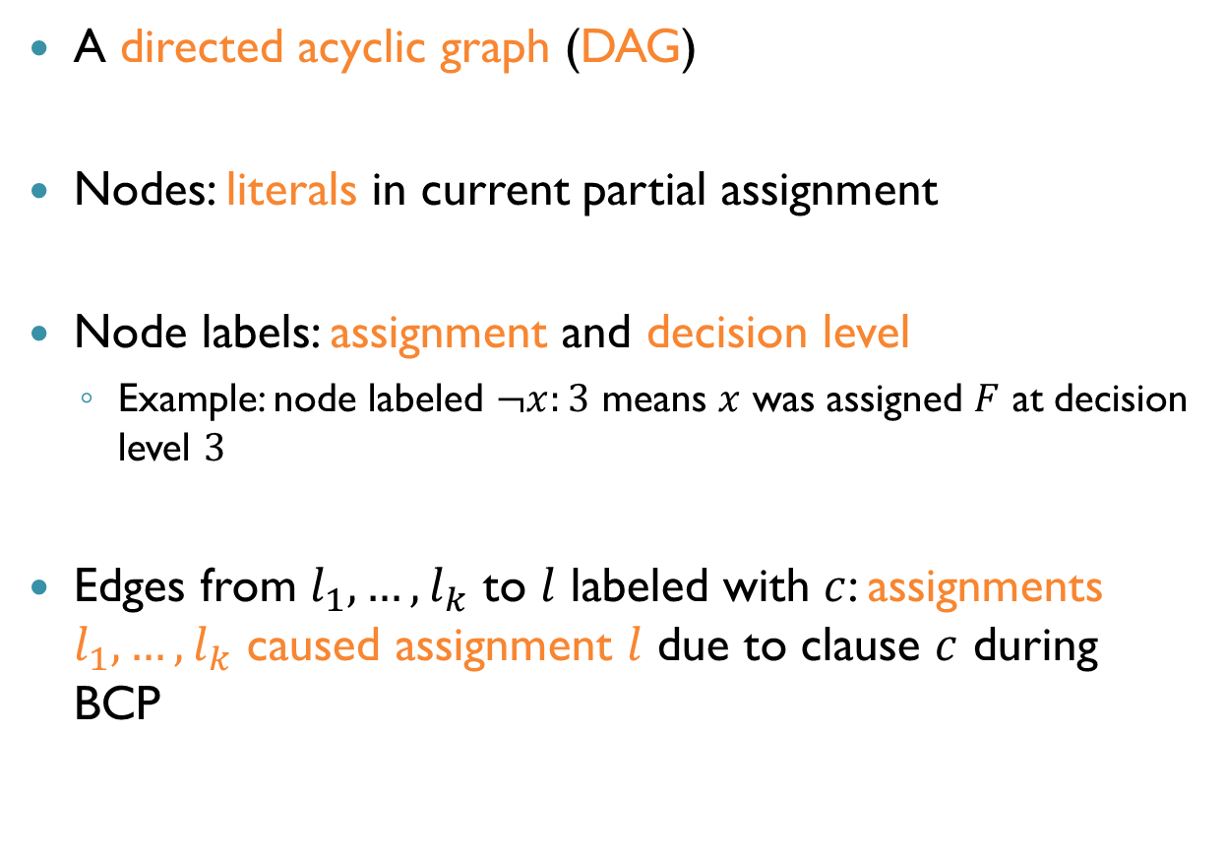
Implication Graph
A directed acyclic graph (DAG)
Nodes: literals in current partial assignment
Node labels: assignment and decision level
Example: node labeled $¬x:3$ means $x$ was assigned $F$ at decision level $3$
Edges from $l_{1},…,l_{k}$ to $l$ labeled with $c$: assignments $l_{1},…, l_{k}$ caused assignment $l$ due to clause $c$ during BCP

Slide 15

Implication Graph (cnt’d)
A special node $C$ is called the conflict node
Edge to conflict node labeled with $c$: current partial assignment contradicts clause $c$

Slide 16










Example: Implication Graph
Clauses: $c_{1}:\left(¬x∨z\right) c_{2}:\left(¬x∨¬y\right) c_{3}:(¬z∨y)$
Assume: search assigned $x←T$ at decision level $2$
BCP yields:
Assignment contradicts $c_{3}$
$$z←T, y←F$$
$$c_{1}$$
$$z:2$$
$$c_{3}$$
Root Node
$$x:2$$
$$C$$
Conflict Node
$$c_{2}$$
$$¬y:2$$
$$c_{3}$$

Slide 17

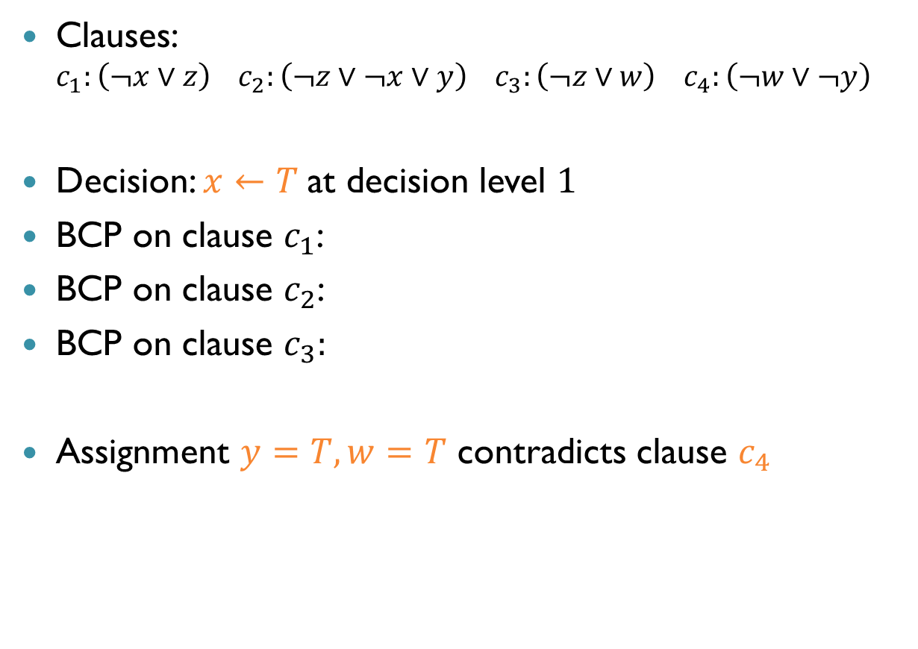


Another Example
Clauses: $c_{1}:\left(¬x∨z\right) c_{2}:\left(¬z∨¬x∨y\right) c_{3}:\left(¬z∨w\right) c_{4}:\left(¬w∨¬y\right)$
Decision: $x←T$ at decision level $1$
BCP on clause $c_{1}$:
BCP on clause $c_{2}$:
BCP on clause $c_{3}:$
Assignment $y=T,w=T$ contradicts clause $c_{4}$
$$z←T$$
$$y←T$$
$$w←T$$

Slide 18











Another Example
Clauses: $c_{1}:\left(¬x∨z\right) c_{2}:\left(¬z∨¬x∨y\right) c_{3}:\left(¬z∨w\right) c_{4}:\left(¬w∨¬y\right)$
Decision: $x←T$ at decision level $1$
Resulting implication graph:
$$z:1$$
$$c_{3}$$
$$w:1$$
$$c_{1}$$
Root Node
$$x:1$$
$$c_{2}$$
$$c_{4}$$
$$c_{2}$$
$$y:1$$
$$c_{4}$$
$$C$$
Conflict Node

Slide 19




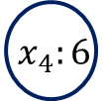





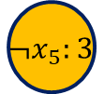





Yet Another Example
$$x_{2}:6$$
$$c_{3}$$
$$x_{4}:6$$
What is $c_{4}$?
What is $c_{3}$?
What is $c_{1}$?
What is $c_{2}$?
$$c_{1}$$
(partial graph)
Root Node
$$x_{1}:6$$
$$c_{4}$$
$$c_{2}$$
$$x_{3}:6$$
$$c_{4}$$
$$C$$
Conflict Node
$$c_{2}$$
$$¬x_{5}:3$$
Root Node
$$¬x_{4}∨¬x_{3}$$
$$x_{4}∨¬x_{2}$$
$$x_{2}∨¬x_{1}$$
$$x_{3}∨¬x_{1}∨x_{5}$$

Slide 20
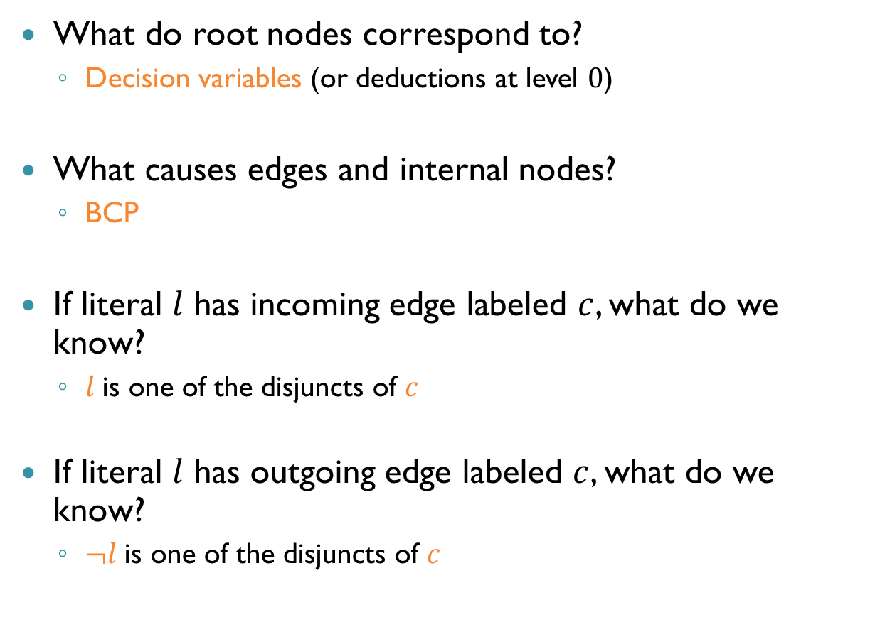
Implication Graph Properties
What do root nodes correspond to?
Decision variables (or deductions at level $0$)
What causes edges and internal nodes?
BCP
If literal $l$ has incoming edge labeled $c$, what do we know?
$l$ is one of the disjuncts of $c$
If literal $l$ has outgoing edge labeled $c$, what do we know?
$¬l$ is one of the disjuncts of $c$

Slide 21
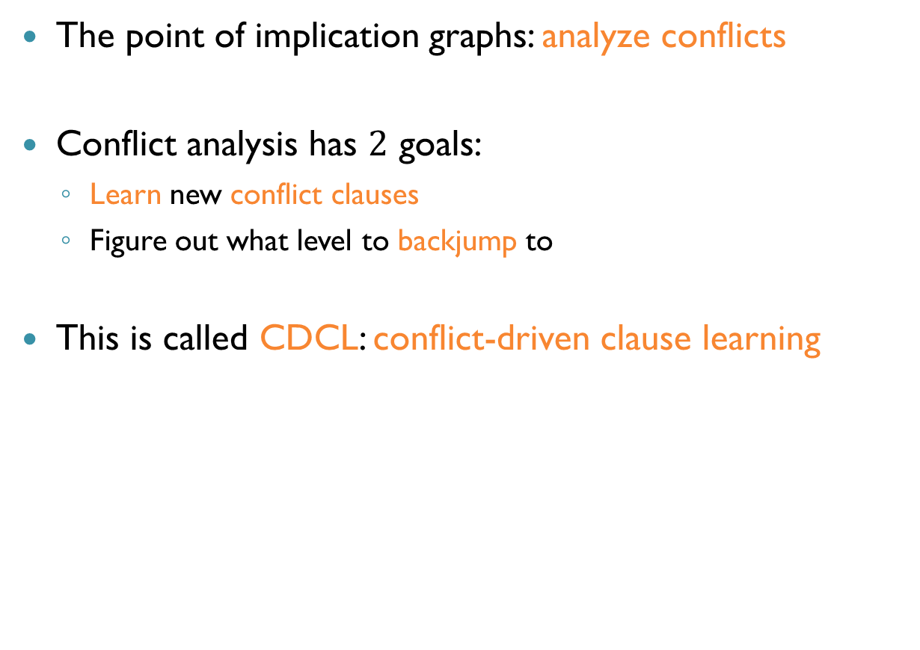
Analyzing Conflicts
The point of implication graphs: analyze conflicts
Conflict analysis has $2$ goals:
Learn new conflict clauses
Figure out what level to backjump to
This is called CDCL: conflict-driven clause learning

Slide 22
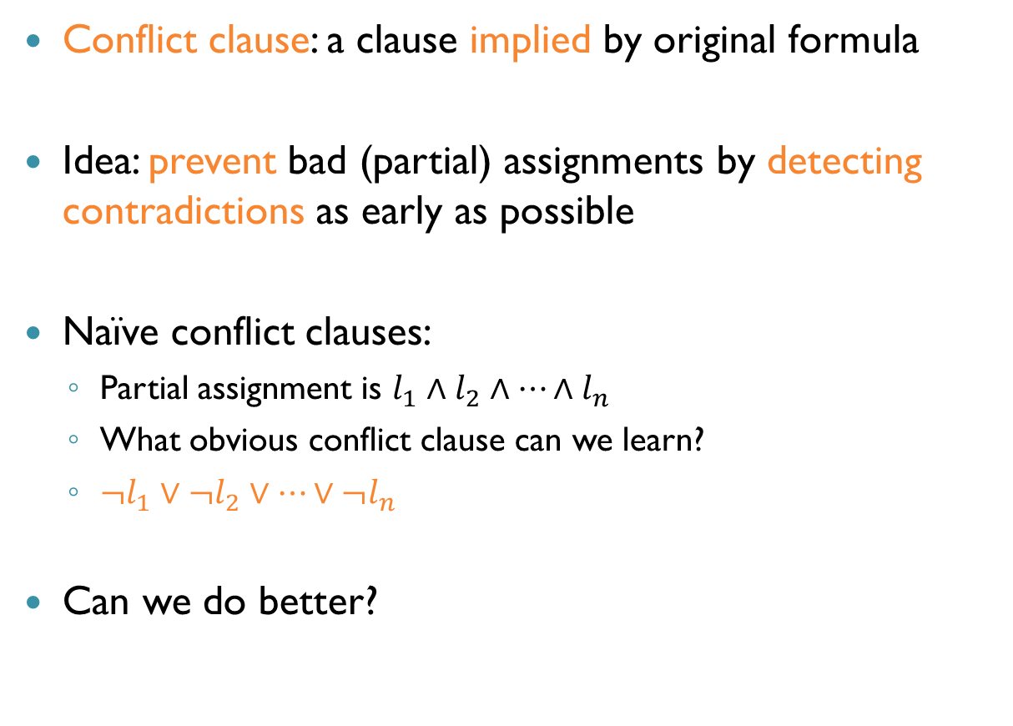
Conflict Clauses
Conflict clause: a clause implied by original formula
Idea: prevent bad (partial) assignments by detecting contradictions as early as possible
Naïve conflict clauses:
Partial assignment is $l_{1}∧l_{2}∧…∧l_{n}$
What obvious conflict clause can we learn?
$¬l_{1}∨¬l_{2}∨…∨¬l_{n}$
Can we do better?

Slide 23
Implication Graphs and Conflict Clauses
Key idea: use implication graph to learn better conflict clauses
Are small or large conflict clauses preferable?
What’s a simple way to do this?

Slide 24




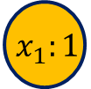











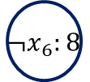


Conflicts from Implication Graphs
$$x_{8}:4$$
$$c_{7}$$
$$x_{1}:1$$
$$c_{2}$$
Trivial conflict clause: $¬x_{8}∨x_{7}∨x_{6}∨x_{5}∨¬x_{4}∨¬x_{1}∨x_{2}∨x_{3}$
Better conflict clause: $¬x_{8}∨x_{7}∨¬x_{1}$
(partial graph)
$$c_{7}$$
$$¬x_{6}:8$$
$$c_{5}$$
$$c_{4}$$
$$¬x_{2}:1$$
$$c_{1}$$
$$¬x_{7}:8$$
$$x_{4}:8$$
$$C$$
$$c_{6}$$
$$¬x_{5}:8$$
$$c_{5}$$
$$c_{3}$$
$$¬x_{3}:8$$
$$c_{1}$$

Slide 25
Analyzing Conflicts
This strategy (negate decisions) is one of the earliest for inferring conflict clauses
But people now use a better heuristic
Key concept: unique implication points (UIP)

Slide 26
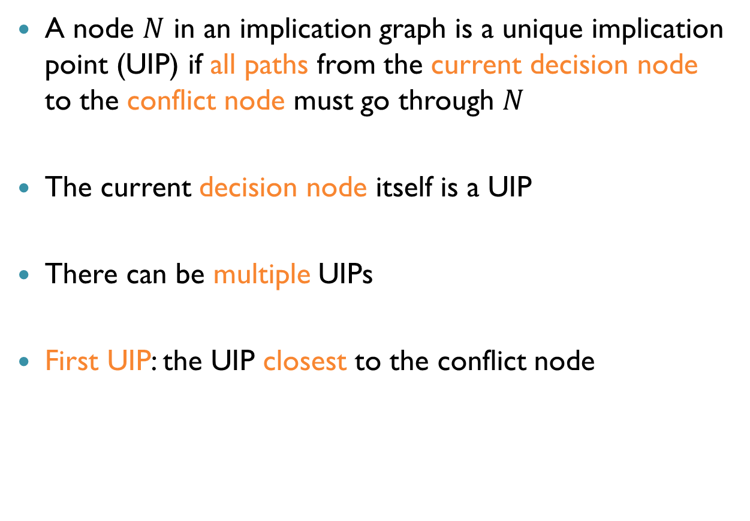
Unique Implication Point
A node $N$ in an implication graph is a unique implication point (UIP) if all paths from the current decision node to the conflict node must go through $N$
The current decision node itself is a UIP
There can be multiple UIPs
First UIP: the UIP closest to the conflict node

Slide 27



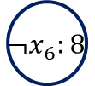



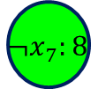









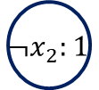
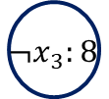

Unique Implication Point (cnt’d)
Which nodes are the UIPs?
Which is the first UIP?
$$x_{8}:4$$
$$c_{7}$$
$$x_{1}:1$$
$$c_{2}$$
(partial graph)
$$c_{7}$$
$$¬x_{6}:8$$
$$c_{5}$$
$$c_{4}$$
$$¬x_{2}:1$$
$$c_{1}$$
Current decision node
$$¬x_{7}:8$$
$$¬x_{7}:8$$
$$x_{4}:8$$
$$x_{4}:8$$
First UIP
$$C$$
$$c_{6}$$
$$¬x_{5}:8$$
$$c_{5}$$
$$c_{3}$$
$$¬x_{3}:8$$
$$c_{1}$$

Slide 28

Boolean (Propositional) Resolution
How can UIPs help us in finding conflict clauses?
Consider two clauses in CNF: $C_{1}:\left(q_{1}∨…∨l∨…∨q_{n}\right) C_{2}:(p_{1}∨…∨¬l∨…∨p_{m})$
We can deduce a new resolvent clause: $C_{3}:(q_{1}∨…∨q_{n}∨p_{1}∨…∨p_{m})$
Correctness:
If $l$ is $T$, some $p_{i}$ must be $T$, so $C_{3}$ is $T$
If $l$ is $F$, some $q_{i}$ must be $T$, so $C_{3}$ is $T$

Slide 29

UIPs and Resolution
Recipe for computing a conflict clause:
Start with the clause labeled on edges entering conflict node
Derive new clauses via resolution, until we find a literal in the first UIP
Specifically:
In current clause $c$, find last assigned literal $l$ in $c$
Pick any incoming edge to $l$ labeled with clause $c′$
Resolve $c$ and $c^{′}$
Set current clause to the resolvent of $c$ and $c′$
Repeat until current clause contains negation of the first UIP literal (as single literal at current decision level)

Slide 30
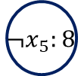



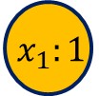















Example: UIPs and Resolution
$$x_{8}:4$$
$$c_{7}$$
$$x_{1}:1$$
$$c_{2}$$
$c_{1}:(x_{2}∨x_{3})$
Last assigned literal: $¬x_{3}$
$c′$ is thus $c_{3}:(¬x_{4}∨¬x_{3})$
Resolve $c_{1}$ and $c_{3}$: $(x_{2}∨¬x_{4})$
$(x_{2}∨¬x_{4})$ is thus the conflict clause
$$c_{7}$$
$$¬x_{6}:8$$
$$c_{5}$$
$$c_{4}$$
$$¬x_{2}:1$$
$$c_{1}$$
$$¬x_{7}:8$$
$$x_{4}:8$$
$$x_{4}:8$$
First UIP
$$C$$
$$c_{6}$$
$$¬x_{5}:8$$
$$c_{5}$$
$$c_{3}$$
$$¬x_{3}:8$$
$$c_{1}$$

Slide 31
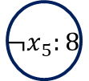





















Correctness
Why is a clause obtained this way…
Implied by the formula?
Because it is obtained by resolution applied to clauses of the original formula
Guaranteed to prevent current assignment?
$$x_{8}:4$$
$$x_{1}:1$$
Conflict: $x_{2}∨x_{3}$
$$c_{7}$$
$$c_{2}$$
Resolve with: $¬x_{4}∨¬x_{3}$
New Conflict: $x_{2}∨¬x_{4}$
$$c_{7}$$
$$¬x_{6}:8$$
$$c_{5}$$
$$c_{4}$$
$$¬x_{2}:1$$
$$c_{1}$$
$$¬x_{7}:8$$
$$x_{4}:8$$
$$x_{4}:8$$
$$C$$
$$c_{6}$$
$$¬x_{5}:8$$
$$c_{5}$$
$$c_{3}$$
$$¬x_{3}:8$$
$$c_{1}$$

Slide 32
Correctness
Why is a clause obtained this way…
Implied by the formula?
Because it is obtained by resolution applied to clauses of the original formula
Guaranteed to prevent current assignment?
Because it forms a cut of the graph, separating decisions from conflicts
In fact, any such cut will do!
But this heuristic seems useful
Leads to short clauses (empirically)

Slide 33
















Another Example
$$¬x_{2}:3$$
$$c_{1}$$
First UIP:
$x_{4}$
Initial conflict:
$\left(x_{7}∨¬x_{6}\right)$
Last assigned literal in conflict:
$¬x_{7}$
Clause on edge to $¬x_{7}$:
$\left(¬x_{5}∨¬x_{6}∨{¬x}_{7}\right)$
$$x_{5}:5$$
$$c_{3}$$
$$¬x_{7}:5$$
$$c_{1}$$
$$x_{4}:5$$
$$c_{3}$$
$$c_{4}$$
$$c_{2}$$
$$x_{6}:5$$
$$c_{4}$$
$$C$$
$$¬x_{9}:2$$
$$c_{2}$$
Resolve $c_{3}$ and $c_{4}$:
$\left(¬x_{5}∨¬x_{6}\right)$
Pick $x_{6}$. Clause on incoming edge:
$\left(¬x_{4}∨x_{9}∨x_{6}\right)$

Slide 34

Another Example
$$¬x_{2}:3$$
$$c_{1}$$
Resolve:
$\left(¬x_{5}∨¬x_{4}∨x_{9}\right)$
Are we done?
Incoming edge to $x_{5}$:
$\left(x_{2}∨¬x_{4}∨x_{5}\right)$
Resolve:
$(x_{2}∨¬x_{4}∨x_{9})$
This is the new conflict clause
$$x_{5}:5$$
$$c_{3}$$
$$¬x_{7}:5$$
$$c_{1}$$
$$x_{4}:5$$
$$c_{3}$$
$$c_{4}$$
$$c_{2}$$
$$x_{6}:5$$
$$c_{4}$$
$$C$$
$$¬x_{9}:2$$
$$c_{2}$$
Resolve $c_{3}$ and $c_{4}$:
$\left(¬x_{5}∨¬x_{6}\right)$
Pick $x_{6}$. Clause on incoming edge:
$\left(¬x_{4}∨x_{9}∨x_{6}\right)$

Slide 35


Conflict Analysis
Recall: conflict analysis has $2$ goals:
Learn new conflict clauses
Figure out what level to backjump to
Backjump to level $d$ means: delete all variable assignments made after level $d$ (but assignments at level $d$ not deleted)

Slide 36
Asserting Clauses
Idea: backjump to a level that makes the conflict clause an asserting clause in the next step
Asserting clause: a clause with exactly one unassigned literal
Hence, BCP will use the new clause to force an assignment

Slide 37

Choosing Backjumping Level
We want to make the conflict clause an asserting clause in the next step. What level should we backtrack to?
Answer: the second highest decision level that appears in the conflict clause
Or level $0$, if conflict clause only has one decision level
Conflict clause contains exactly one literal, $l$, from the highest decision level – so $l$ will be asserted next

Slide 38




Example: Backjumping
$$x_{8}:4$$
$$c_{7}$$
$$x_{1}:1$$
$$c_{2}$$
Conflict clause:
$(x_{2}∨¬x_{4})$
What level do we backtrack to?
$1$
What gets erased?
What does BCP do next?
$$c_{7}$$
$$¬x_{6}:8$$
$$c_{5}$$
$$c_{4}$$
$$¬x_{2}:1$$
$$c_{1}$$
$$x_{2}∨¬x_{4}$$
$$¬x_{7}:8$$
$$¬x_{4}:1$$
$$C$$
$$x_{4}:8$$
First UIP
$$c_{6}$$
$$¬x_{5}:8$$
$$c_{5}$$
$$c_{3}$$
$$¬x_{3}:8$$
$$c_{1}$$

Slide 39

Backjumping Too Far?
As we just saw, a lot of information can be lost
All propagations on levels $2$ to $7$…
Empirically, this is often better!
Reason: the solver uses heuristics for choosing the decision variables, and now better variables may be selected

Slide 40






















Example: CDCL
$$c_{1}: ¬x_{1}∨¬x_{4}∨x_{5} \\ c_{2}: ¬x_{4}∨x_{6} \\ c_{3}: ¬x_{5}∨¬x_{6}∨x_{7} \\ c_{4}: ¬x_{7}∨x_{8} \\ c_{5}: ¬x_{2}∨¬x_{7}∨x_{9} \\ c_{6}: ¬x_{8}∨¬x_{9} \\ c_{7}: ¬x_{8}∨x_{9}$$
$$c_{8}:¬x_{2}∨¬x_{7}$$
$$x_{3}:3$$
$$x_{2}:2$$
$$c_{5}$$
$$c_{1}$$
$$x_{5}:4$$
$$c_{3}$$
$$x_{9}:4$$
$$c_{6}$$
$$c_{5}$$
$$x_{1}:1$$
$$x_{7}:4$$
$$c_{1}$$
$$x_{7}:4$$
$$C$$
$$x_{6}:4$$
$$c_{4}$$
$$x_{8}:4$$
$$c_{3}$$
$$c_{6}$$
$$x_{4}:4$$
$$c_{2}$$

Slide 41








Example: CDCL
$$c_{1}: ¬x_{1}∨¬x_{4}∨x_{5} \\ c_{2}: ¬x_{4}∨x_{6} \\ c_{3}: ¬x_{5}∨¬x_{6}∨x_{7} \\ c_{4}: ¬x_{7}∨x_{8} \\ c_{5}: ¬x_{2}∨¬x_{7}∨x_{9} \\ c_{6}: ¬x_{8}∨¬x_{9} \\ c_{7}: ¬x_{8}∨x_{9}$$
$$c_{8}:¬x_{2}∨¬x_{7} \\ c_{9}:¬x_{1}∨¬x_{4}∨x_{7}$$
$$x_{3}:3$$
$$x_{2}:2$$
$$c_{8}$$
$$c_{1}$$
$$x_{5}:4$$
$$c_{3}$$
$${¬x}_{7}:2$$
$$x_{1}:1$$
$$c_{1}$$
$$C$$
$$c_{3}$$
$$x_{6}:4$$
$$c_{3}$$
$$x_{4}:4$$
$$c_{2}$$
$$x_{4}:4$$

Slide 42















Example: CDCL
$$c_{1}: ¬x_{1}∨¬x_{4}∨x_{5} \\ c_{2}: ¬x_{4}∨x_{6} \\ c_{3}: ¬x_{5}∨¬x_{6}∨x_{7} \\ c_{4}: ¬x_{7}∨x_{8} \\ c_{5}: ¬x_{2}∨¬x_{7}∨x_{9} \\ c_{6}: ¬x_{8}∨¬x_{9} \\ c_{7}: ¬x_{8}∨x_{9}$$
$$c_{8}:¬x_{2}∨¬x_{7} \\ c_{9}:¬x_{1}∨¬x_{4}∨x_{7} \\ c_{10}:¬x_{8}$$
$$x_{3}:3$$
$$x_{2}:2$$
$$c_{8}$$
$${¬x}_{7}:2$$
$$c_{9}$$
$$x_{1}:1$$
$$c_{9}$$
$${¬x}_{4}:2$$
$$x_{5}:4$$
$$c_{3}$$
$$¬x_{6}:4$$
$$c_{3}$$
$$x_{8}:5$$
$$c_{6}$$
$$x_{8}:5$$
$${¬x}_{9}:5$$
$$c_{7}$$
$$c_{7}$$
$$C$$

Slide 43



Example: CDCL
$$c_{1}: ¬x_{1}∨¬x_{4}∨x_{5} \\ c_{2}: ¬x_{4}∨x_{6} \\ c_{3}: ¬x_{5}∨¬x_{6}∨x_{7} \\ c_{4}: ¬x_{7}∨x_{8} \\ c_{5}: ¬x_{2}∨¬x_{7}∨x_{9} \\ c_{6}: ¬x_{8}∨¬x_{9} \\ c_{7}: ¬x_{8}∨x_{9}$$
$$c_{8}:¬x_{2}∨¬x_{7} \\ c_{9}:¬x_{1}∨¬x_{4}∨x_{7} \\ c_{10}:¬x_{8}$$
$$x_{3}:3$$
$$x_{2}:2$$
$$c_{8}$$
$${¬x}_{7}:2$$
$$c_{9}$$
$$x_{1}:1$$
$$c_{9}$$
$${¬x}_{4}:2$$
$$x_{5}:4$$
$$c_{3}$$
$$¬x_{6}:4$$
$$c_{3}$$
$$¬x_{8}:0$$
$$I=\{x_{1},x_{2},x_{3},¬x_{4},x_{5},¬x_{6},¬x_{7},¬x_{8},x_{9}\}$$
$$x_{9}:5$$

Slide 44

Recap: Solver Architecture
UNSAT
Propositional Formula
SAT Solver
SAT + Assignment
SAT Solver
No Conflict
BCP
Preprocess Formula
Decide
Conflict
Backjump
($d≥0)$
Analyze Conflict
SAT
UNSAT

Slide 45
Decision Heuristics
Important, but sometimes voodoo
Easy to come up with many heuristics
We’ll talk about two common ones:
Dynamic largest individual sum (DLIS)
Variable state independent decaying sum (VSIDS)

Slide 46

Dynamic Largest Individual Sum (DLIS)
Choose the literal satisfying as many currently unsatisfied clauses as possible
Example: $\left(x_{1}∨¬x_{2}\right)∧\left(¬x_{2}∨x_{3}\right)∧(¬x_{1}∨x_{2}∨¬x_{3})$
What would DLIS pick?
$x_{2}←F$
Dynamic – need careful implementation of bookkeeping

Slide 47

Variable State Independent Decaying Sum (VSIDS)
Similar to DLIS, but smaller overhead. Favors literals involved in conflicts (conflict driven)
Keep score for each literal: number of clauses in which it appears
Every time a clause with literal $l$ is added, increase score for $l$
Periodically divide scores of all literals by $2$ (decaying sum)

Slide 48
Implementing SAT Solvers
Competitive solvers need to minimize the overhead of the Decide, BCP and Analyze Conflict steps
We’ll discuss two issues:
Number of conflict clauses
Implementing BCP with watch literals

Slide 49

Conflict Clauses
Recall: after conflict analysis, we add a new clause to the formula
Advantage: new clause blocks future bad assignments
Disadvantage: more clauses, more overhead
This is a tradeoff!
For this reason, many solvers keep last $n$ conflict clauses for some $n$
Rational: older conflicts perhaps less relevant

Slide 50

Implementing BCP
Critical part of the implementation
Solvers may spend up to $80\%$ of the time doing BCP
Naïve way: scan all currently unsatisfied clauses
Modern solvers store millions of clauses – impractical!
Better approach: keep mapping from each literal to all clauses where it appears
But still expensive, because a literal may appear in many clauses

Slide 51

Watch Literals
Goal of BCP is to figure out which variable assignments imply which others
Observe clause $(l∨l_{1}∨…∨l_{k})$, and suppose we assign $l←F$
When will a new variable assignment be implied?
Answer: only if clause has one more unassigned literal
Idea: only look at clauses with at most two unassigned literals

Slide 52
Watch Literals (cnt’d)
Select two unassigned literals in each unsatisfied clause as watch literals
Invariant: watch literals are always unassigned
To maintain invariant: if a watch literal is assigned and clause has other unassigned literals, select a new watch literal
As long as watch variables exist, no point in trying BCP

Slide 53

Watch Literals (cnt’d)
When we assign $l←T$, which clauses can imply new assignments?
If $¬l$ does not appear in clause, no hope
If $¬l$ appears but is not a watch literal, also no hope
So, look only at clauses where $¬l$ is a watch literal
Which is fewer than all clauses where $¬l$ appears
This little trick yielded a huge improvement in solver performance

Slide 54
Summary
Most competitive solvers today based on DPLL, but with extensions:
Backjumping, conflict clause learning, decision heuristics and engineering tricks
Referred to as conflict-driven clause learning (CDCL)
There are also solvers based on other approaches, such as stochastic search
Next time: applications!

